Slide 1

Research Data Management www.globusonline.org
Rachana Ananthakrishnan
University of Chicago & Argonne National Lab

Slide 2

We started with technology proven in many large-scale grids
GridFTP
GRAM
MyProxy GSI-OpenSSH
…

Slide 3
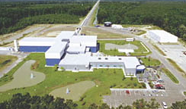
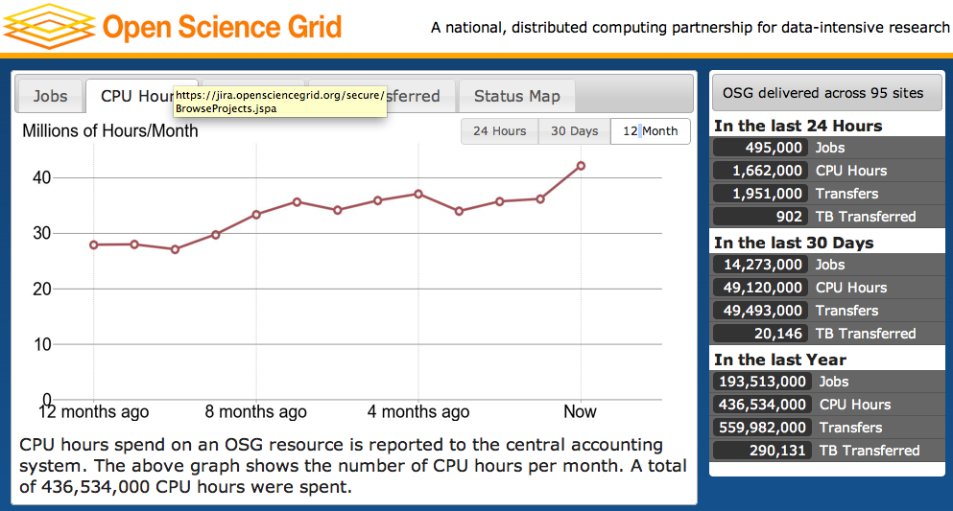



Big science has achieved big successes with advanced community services
OSG: 1.4M CPU-hours/day, >90 sites, >3000 users,
>260 pubs in 2010
LIGO: 1 PB data in last science run, distributed worldwide
Substantial teams
Sustained effort
Leverage common technology
Application-specific solutions
Production focus
ESG: 1.2 PB climate data
delivered to 23,000 users; 600+ pubs
Community services built on Globus Toolkit software

Slide 4
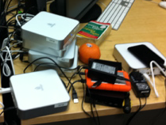
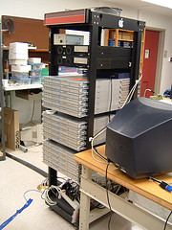
But small and medium science is suffering
Data deluge
Ad-hoc solutions
Inadequate software,
hardware & IT staff
Notes:
DES as an example of medium science

Slide 5
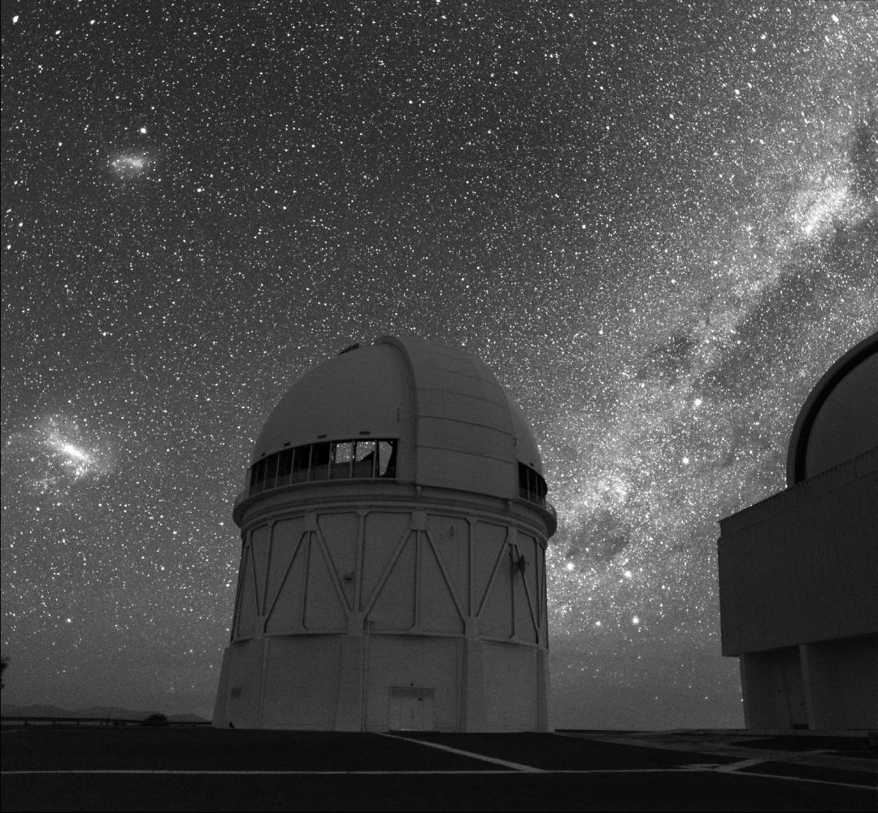
Medium science: Dark Energy Survey
Blanco 4m on Cerro Tololo
Every night, they receive 100,000 files in Illinois
They transmit files to Texas for analysis …
then move results back to Illinois …
and make them available to users
Process must be reliable, routine, and efficient
The cyberinfrastructure team is not large!
Image credit: Roger Smith/NOAO/AURA/NSF
Notes:
Not just small labs—medium science too.
E.g., Dark Energy Survey.

Slide 6
Time-consuming Tasks in Research
Run experiments
Collect data
Manage data
Move data
Acquire computers
Analyze data
Run simulations
Compare experiment
with simulation
Search the literature
Communicate with colleagues
Publish papers
Find, configure, install relevant software
Find, access, analyze relevant data
Order supplies
Write proposals
Write reports
…

Slide 7
Excerpts from ESNet reports
“Transfers often take longer than expected based on available network capacities”
“Lack of an easy to use interface to some of the high-performance tools”
“Tools [are] too difficult to install and use”
“Time and interruption to other work required to supervise large data transfers”
“Need data transfer tools that are easy to use, well-supported, and permitted by site and facility cybersecurity organizations”

Slide 8
We envisage a world where data …
… flows rapidly, reliably, and securely among:
experimental facilities,
online and archival storage,
computing facilities, and
remote institutions

Slide 9
We envisage a world where data …
… is easily integrated into dynamic datasets that also include metadata and programs necessary to understand and regenerate it

Slide 10
We envisage a world where data …
… is readily discoverable and accessible to collaborators, regardless of their and the data’s location

Slide 11

We believe a new approach is needed to deliver data management infrastructure
Frictionless
Affordable
Sustainable
Like … but for science!

Slide 12
Focusing on “frictionless”, we’ve started to do this with the Globus Online service …
Transfer and sharing of
large data sets …
… with dropbox-like characteristics …
… directly from your own storage systems

Slide 13


Reliable, secure, high-performance file transfer
“Fire-and-forget” transfers
Automatic fault recovery
Auto tuning
Seamless security integration
2
Globus Online moves and syncs files
Data
Source
Data
Destination
1
User initiates transfer request
3
Globus Online notifies user

Slide 14
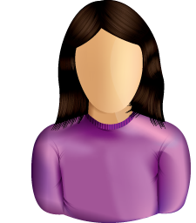
Simple, secure sharing off existing storage systems
Easily share large data with any user or group
No cloud storage required
2
Globus Online tracks shared files; no need to move files to cloud storage!
Data
Source
1
User A selects file(s) to share, selects user or group, and sets permissions
3
User B logs in to Globus Online and accesses shared file

Slide 15
Globus Online is SaaS
Web, command line, and REST interfaces
Reduced IT operational costs
New features automatically available
Consolidated support & troubleshooting
Easy to add your laptop, server, cluster, supercomputer, etc. with Globus Connect

Slide 16


Globus Connect Multiuser
Local Storage System
(RCC cluster, campus server, …)
Globus Connect Multiuser
MyProxy
Online CA
GridFTP Server
Local system users
Create endpoint in minutes; no complex GridFTP install
Enable all users with local accounts to transfer files
Native packages: RPMs and DEBs
Also available as part of the Globus Toolkit

Slide 17
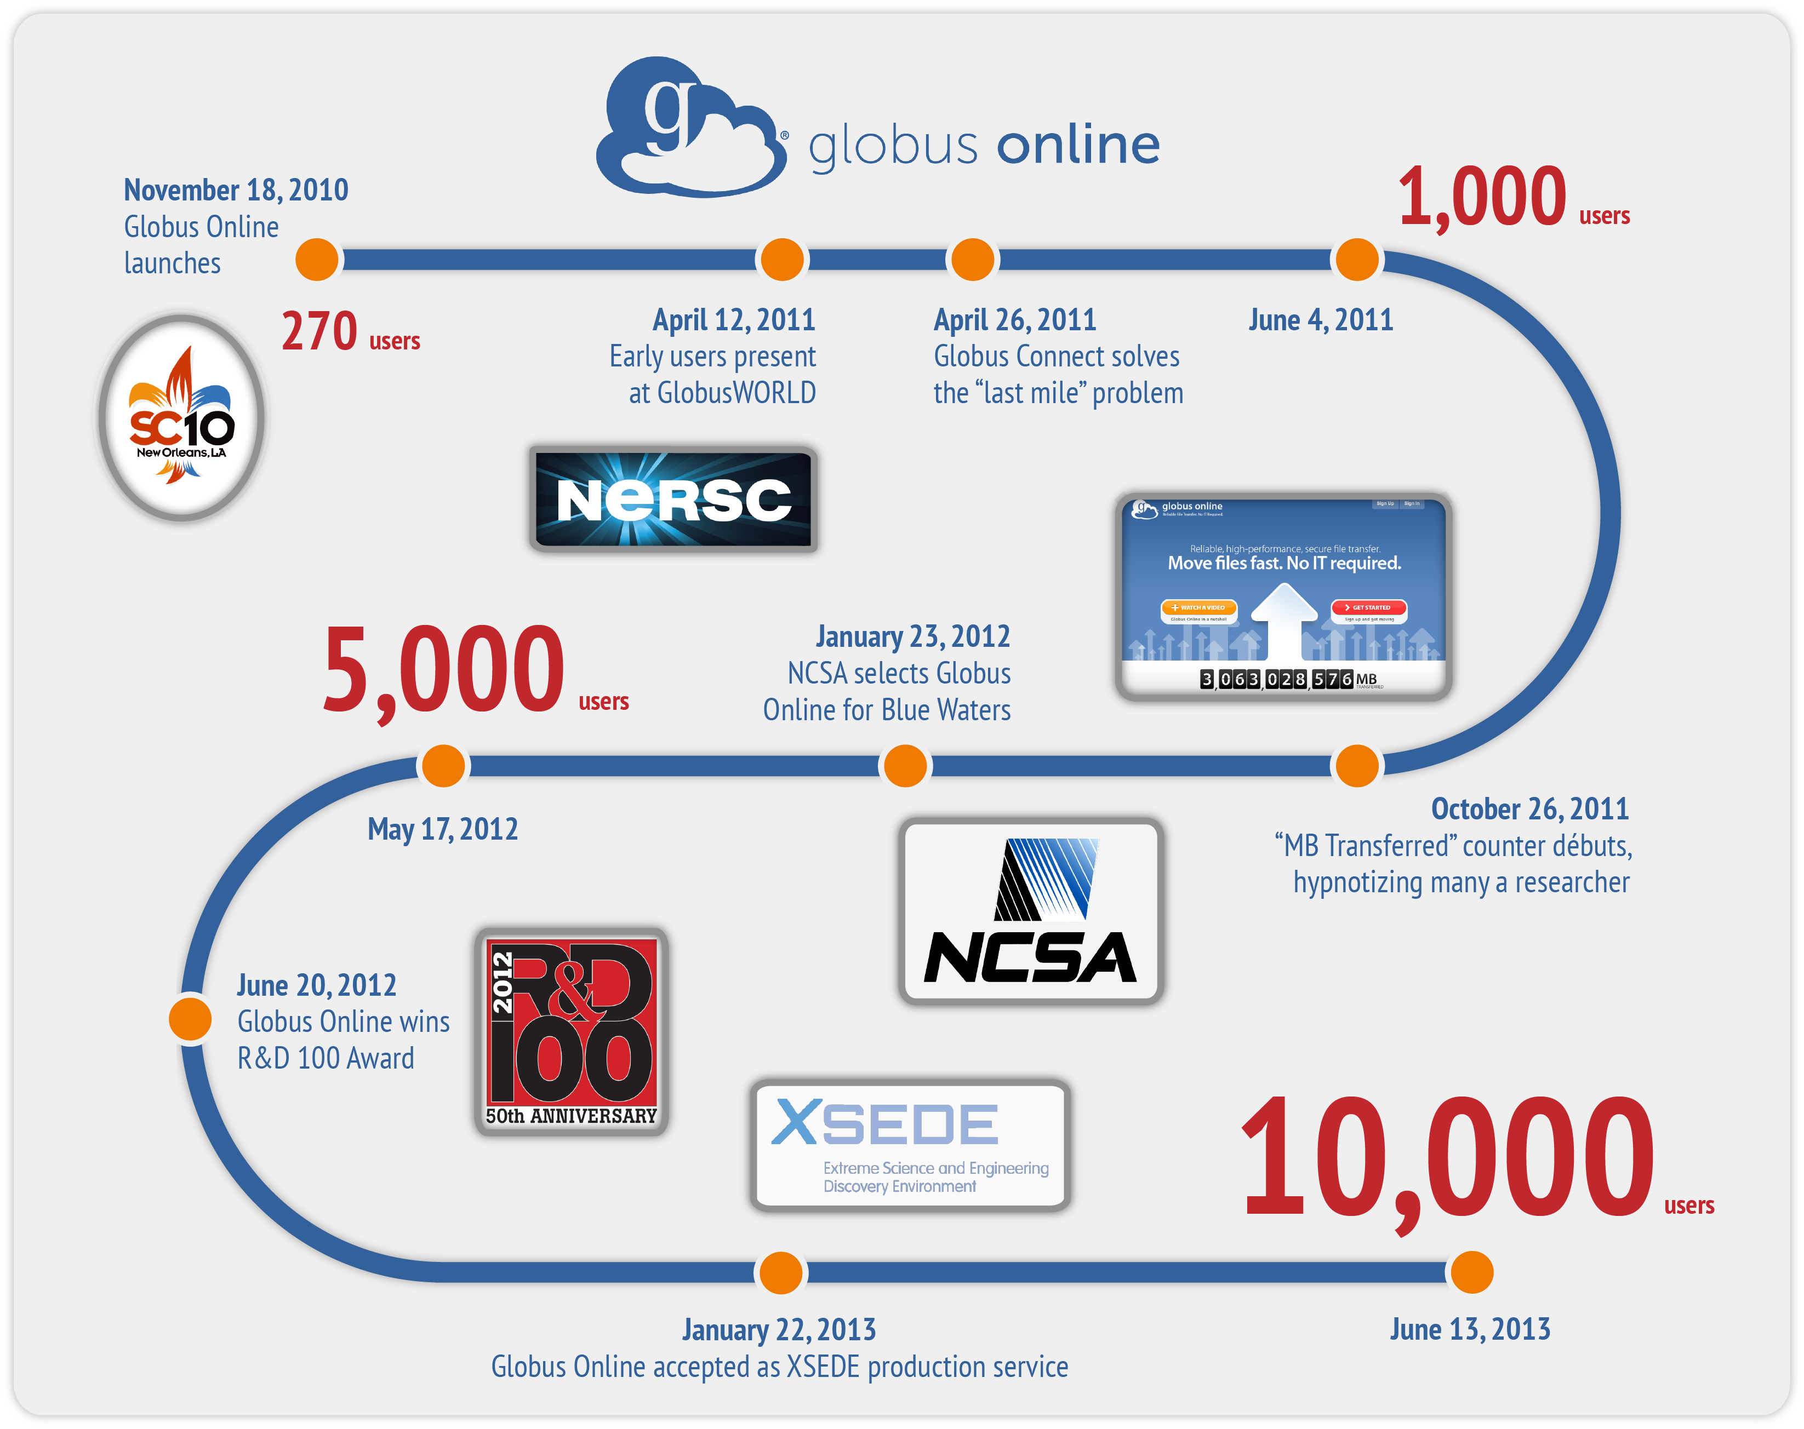
Early adoption is encouraging

Slide 18
Early adoption is encouraging
~24PB and 1B files moved
10x (or better) performance vs. scp
99.9% availability

Slide 19
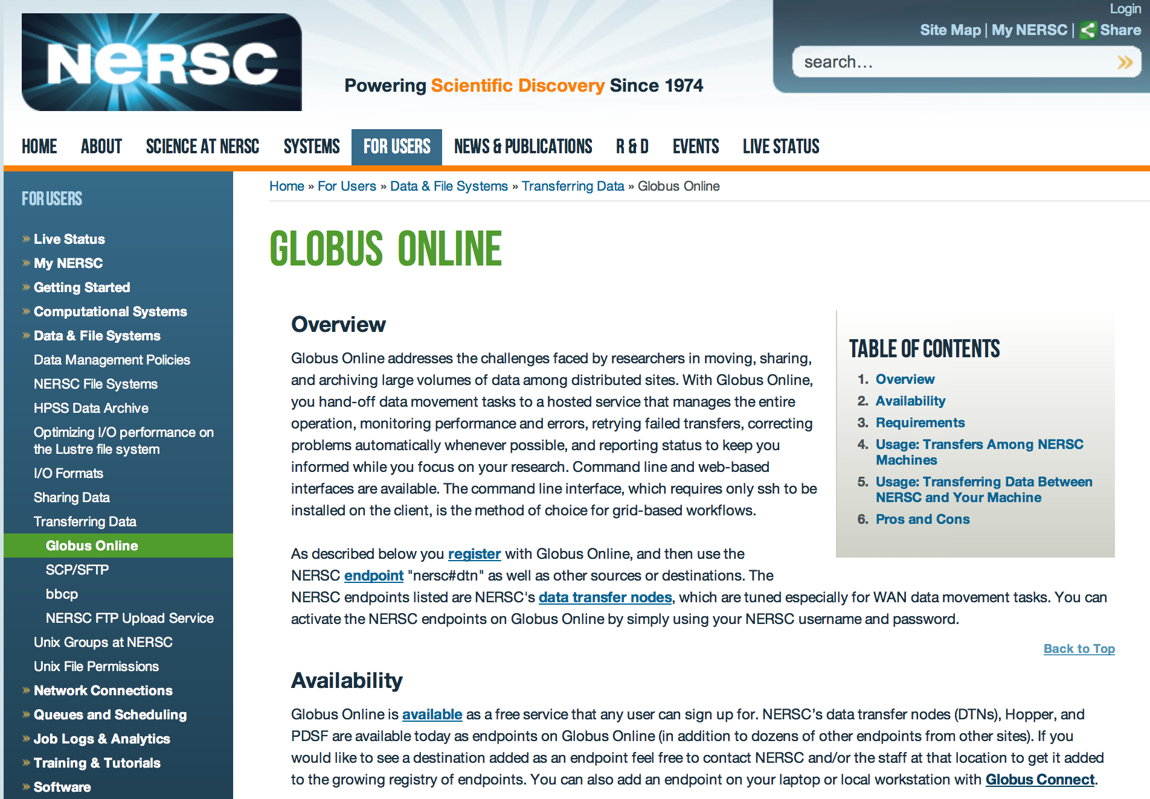

Slide 20
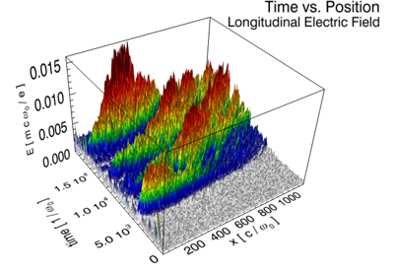
B. Winjum (UCLA) moves 900K-file plasma physics datasets UCLA →NERSC

Slide 21
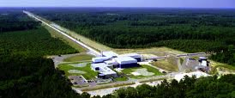
Dan Kozak (Caltech) replicates 1 PB LIGO astronomy data for resilience

Slide 22
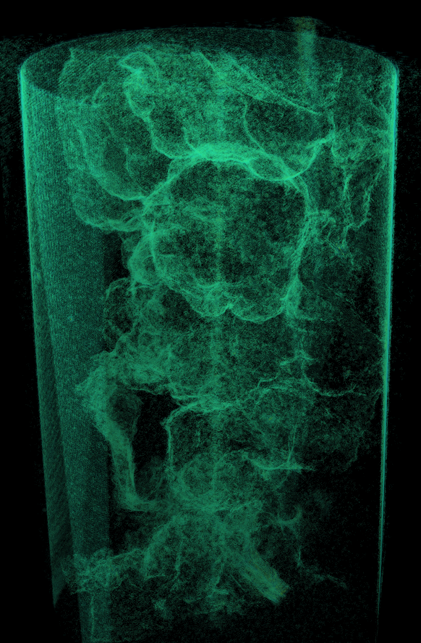
Erin Miller (PNNL) collects data at Advanced Photon Source, renders at PNNL, and views at ANL
Credit: Kerstin Kleese-van Dam
Notes:
This image shows a 3D rendering of a Shewanella biofilm grown on a flat plastic substrate in a Constant Depth bioFilm Fermenter (CDFF). The image was generated using x-ray microtomography at the Advanced Photon Source, Argonne National Laboratory.

Slide 23







Globus Online as a platform
Globus Online APIs
…
Globus Connect
Dataset Services
Sharing Service
Transfer Service
Globus Nexus (Identity, Group, Profile)
Globus Toolkit

Slide 24
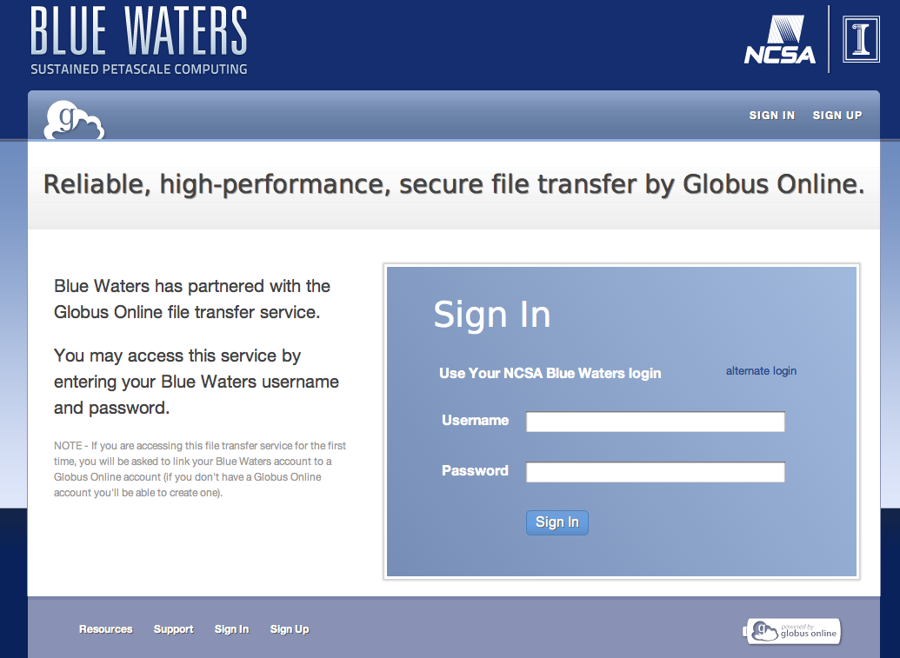
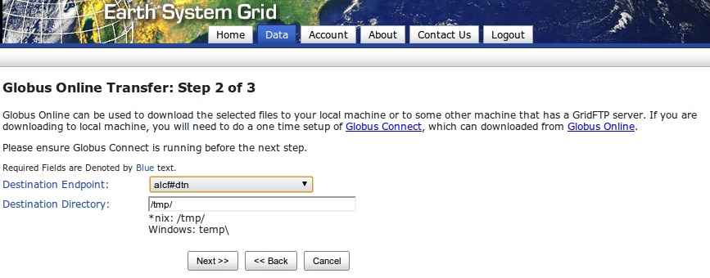
Early platform adopters

Slide 25
More capabilities underway …
Globus Online APIs
Globus Connect
Dataset Services
Sharing Service
Transfer Service
Globus Nexus (Identity, Group, Profile)
Globus Toolkit

Slide 26
Introducing the dataset
Group data based on use, not location
  Logical grouping to organize, reorganize, search, and describe usage
Tag with characteristics that reflect content …
  Capture as much existing information as we can
…or to reflect current status in investigation
  Stage of processing, provenance, validation, ..
Share data sets for collaboration
  Control access to data and metadata
Operate on datasets as units
  Copy, export, analyze, tag, archive, …

Slide 27
Expanding Globus Online services
Ingest and publication
  Imagine a DropBox that not only replicates, but also extracts metadata, catalogs, converts
Cataloging
  Virtual views of data based on user-defined and/or automatically extracted metadata
Integration with computation
  Associate computational procedures, orchestrate application, catalog results, record provenance

Slide 28

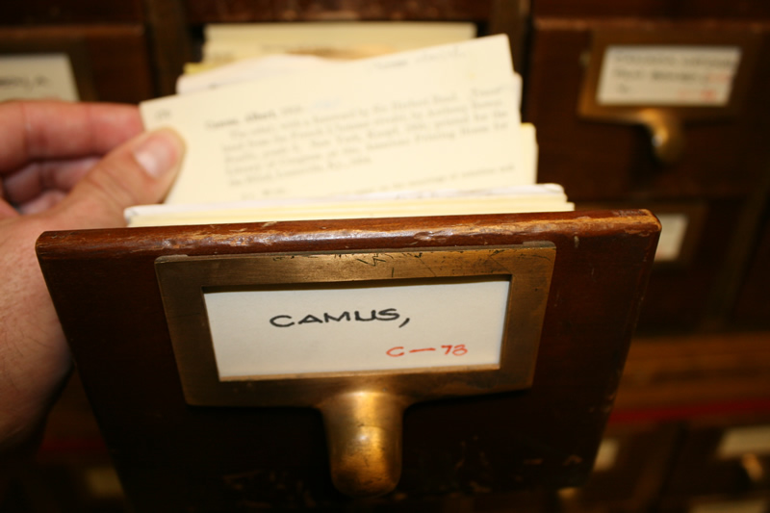
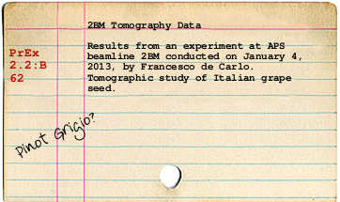
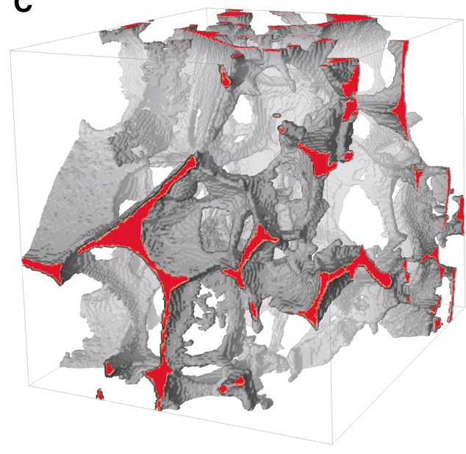
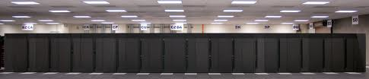
Annotate, share
browse, search
Catalog derived products
Tomography
Populate catalog(s)
mydata42
Record
provenance
Define dataset
Infer type
Extract metadata
analyze
owner: Francesco
type: 3dtomo
format: HDF5
beamline: 2BM
Organization
Orchestration
Locate datasets
Access files
transfer/schedule
Notes:
http://www.blyberg.net/card-generator/
http://www.sciencemag.org/content/332/6025/88/F1.large.jpg

Slide 29
We believe a new approach is needed to deliver data management infrastructure
Frictionless
Affordable
Sustainable

Slide 30
We’ve got a handle on “frictionless”
Web interface, REST API, command line
InCommon, Oauth, OpenID, X.509, …
Credential management
Group definition and management
Transfer management and optimization
Reliability via transfer retries
One-click “Globus Connect” install
5-minute Globus Connect Multiuser install

Slide 31
“Affordable” and “sustainable”?
Common expectation is either:
  High-priced commercial software (with generally higher levels of quality)
Or:
  Free, open source software (with generally lower levels of quality)
We aim to offer the best of all worlds!

Slide 32
We are a non-profit service provider to the non-profit research community

Slide 33
We are a non-profit service provider to the non-profit research community
Our challenge:
Sustainability

Slide 34
Globus Online Provider Plans
Support ongoing operations
Offer value-added capabilities
Engage more closely with users

Slide 35
Provider Plans offer…
Endpoint management console
Usage reporting
MSS optimizations
Globus Plus subscriptions
Branded web sites
Alternate identity provider
Starting at $10k/year

Slide 36
Researchers may use Globus file transfer for free
File transfer and synchronization to/from servers
Personal endpoints with Globus Connect
Access to shared endpoints created by others
Globus Plus: $7/month (or $70/year)
  Create and manage shared endpoints
  Transfer and sharing between Globus Connect Personal endpoints

Slide 37





























We hope you will join us

Slide 38
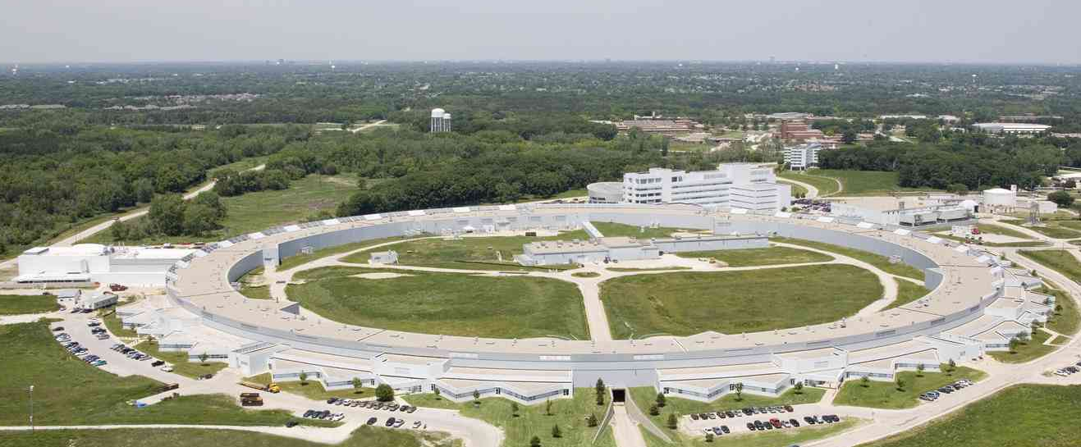


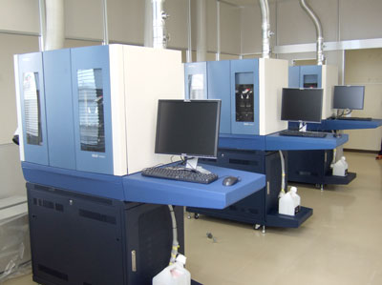
Provider Plan not required to get started
Use Globus Connect Multiuser to easily connect your resources with Globus Online
Go to: globusonline.org/gcmu
Registry
Registry
Staging Store
Ingest
Store
Ingest
Store
Community Store
Community Store
Analysis
Store
Analysis
Store
Archive
Mirror
Archive
Mirror

Slide 39




Our research is supported by:
U.S. DEPARTMENT OF
ENERGY

Slide 40
Questions
Contact: support@globusonline.org
Providers: globusonline.org/provider-plans
Researchers: globusonline.org/plus
  www.globusonline.org

